Slide 1


Data Cleaning and Preparation
>each column converted to appropriate data types
>auto remove duplicates and nulls applied
>no outliers found
>Columns with zero variance had bee removed
Notes:
Hi my name is assem ihab,
And here are the findings from the first dats (data cleaning and preparation) (look at the slide)

Slide 2
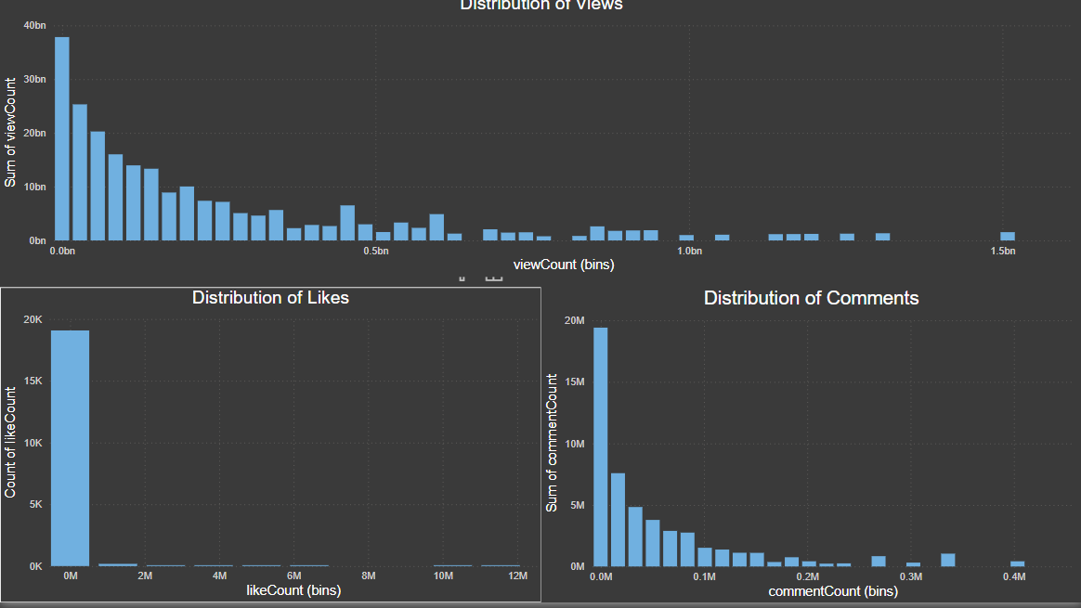
Distibutions (EDA)
Notes:
Here is the distribution of likes, views, and comments counts (all three are highly left-skewed).

Slide 3
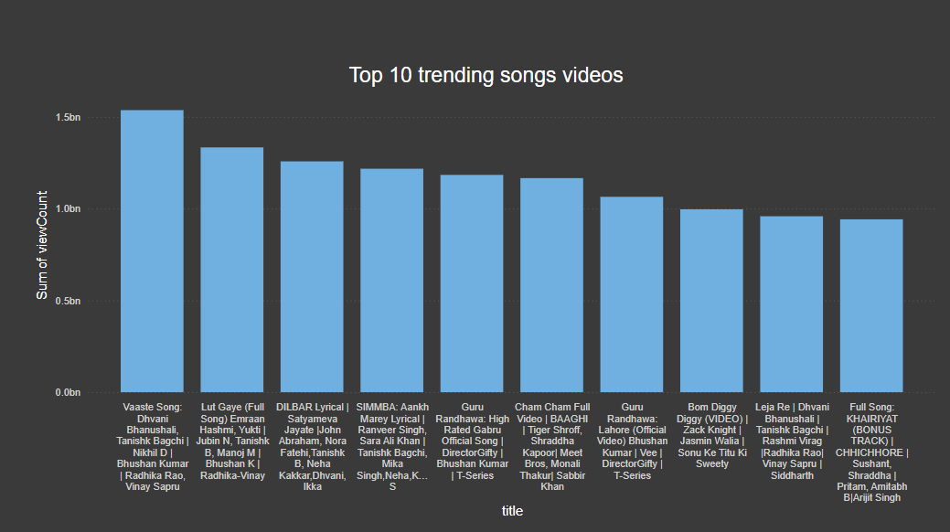
Trending songs
Notes:
Here are the top 10 trending songs with view counts exceeding 1.5 billion, with the lowest among them having 1 billion views.

Slide 4
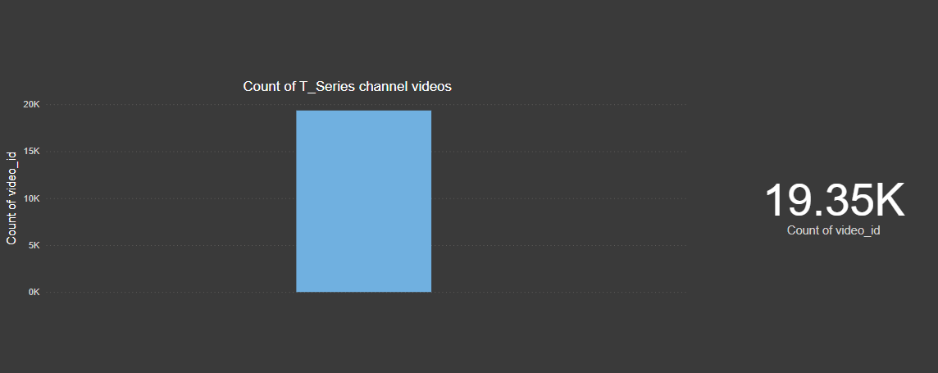
Analyzing distribution of videos among channels
Notes:
This slide analyzes the distribution of videos across channels, noting that T-Series has nearly 20,000 videos.

Slide 5
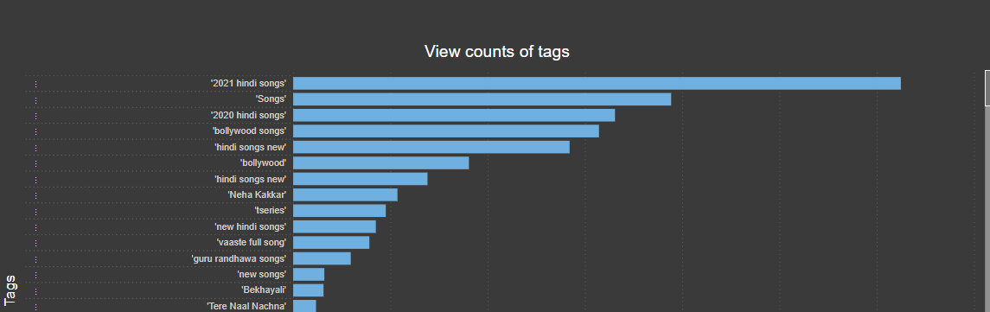
Here are the view counts tags
Notes:
The most popular tag is 2021 hindi songs and the least popular one among them is latest Punjabi songs

Slide 6
The best publishing time is at 4

Slide 7
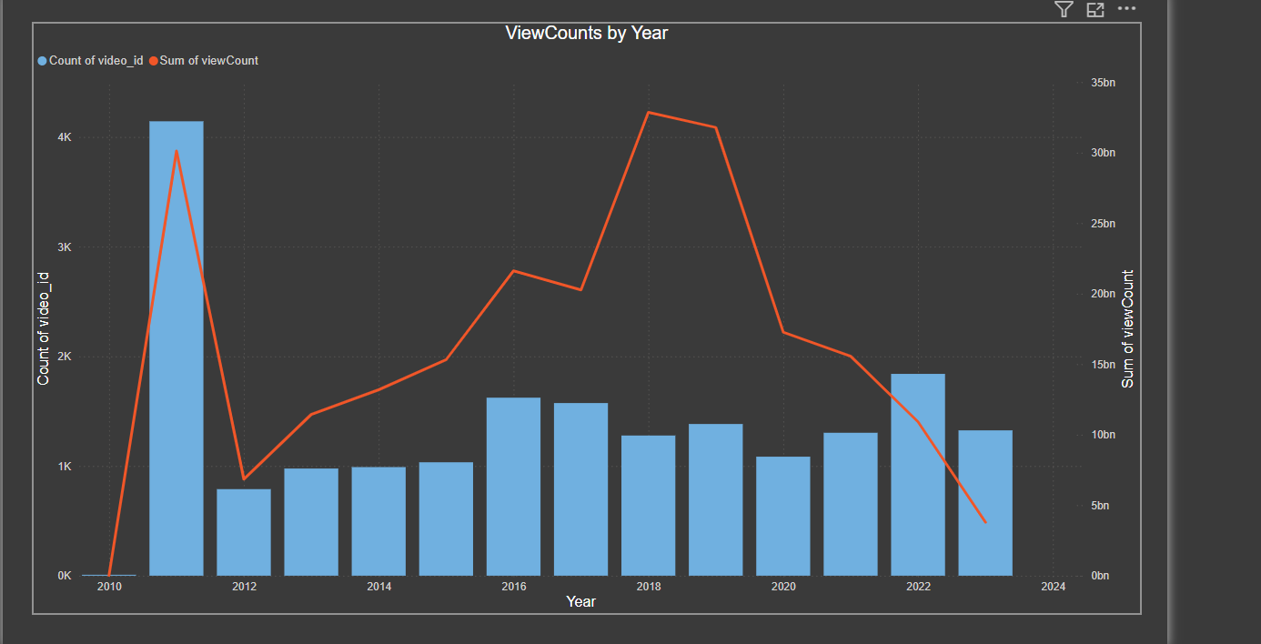
Notes:
A chart for view vount by year

Slide 8
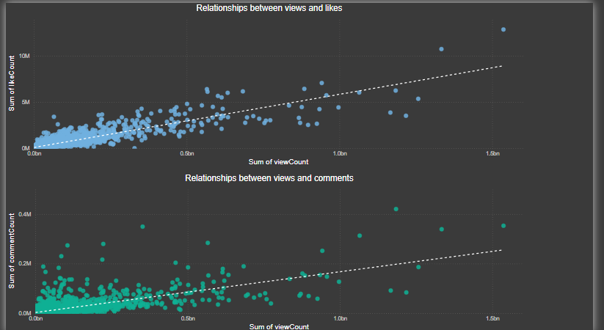
Notes:
As expected, there is a good positive relationship between the views count and likes count and also views count and comments count.

Slide 9
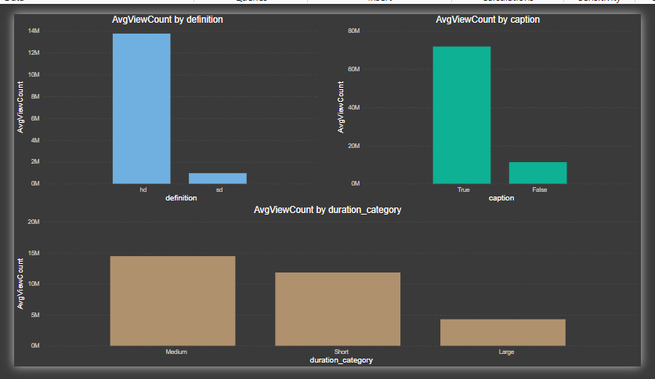
Notes:
Here are the factors influencing the view counts, the high definition got more views the existence of caption increase views the medium duraction category got the highest number of views among all types of videos

